Slide 1
User Interfaces
Kay Kasemir
Jan. 2022

Slide 2
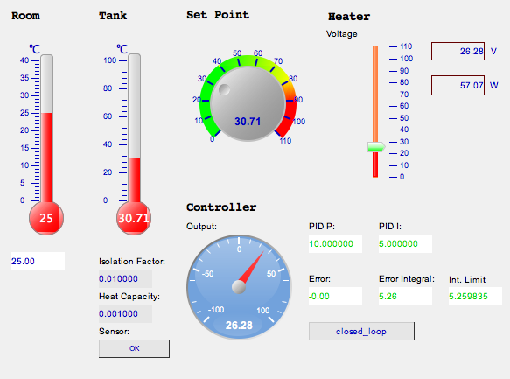
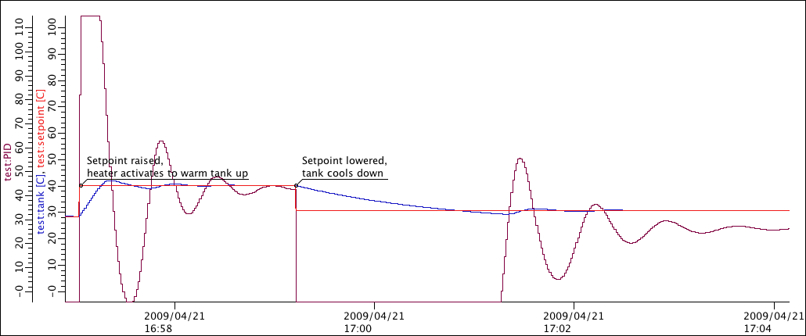
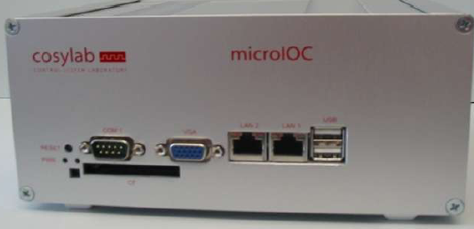
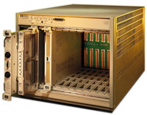
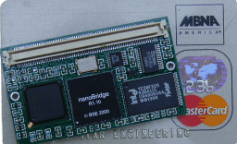
EPICS: Distributed System
Servers Clients
IOC
User Interface
IOC
Archive
IOC
Alarm Handler

Slide 3
“Program" vs. ”Display Manager”
Tcl/tk, Matlab, Delphy, Visual Basic, Python/Qt, … and CA client library
You can program sophisticated displays
Nobody else will understand and maintain your code
In 5..10 years, you have to re-implement it
Edd/dm, medm, dm2k, edm, CS-Studio *.opi, CS-Studio *.bob
Use provided Widgets
  ‘Label’, ’Text Update’, …
Operators can easily tweak your displays or create new ones
In 5..10 years, there is hope for translating displays to a new tool

Slide 4
Over the years

Slide 5
What changes, what doesn’t?
Basic dial-by-number
Import “Contacts”, Name & Number
Custom ring tones, icons, .. in “Contacts”
Speed dial
Apps

Slide 6
Over the years
IOC
User Interface
Since ~1990:
record(ai, “my_record”)
{
field(DTYP, “MyDevice”)
field(INP , “@channel2”)
field(SCAN, “1 second”)
...
More supported platforms:
vxWorks, RTEMS, Linux, OS X, Windows, ..
68000, Intel, PPC, Arm, ..
edd/dm 198x
medm 199x
edm 200x
CS-Studio 201x
2009: BOY
2017: Display Builder
2019: Web Runtime
Also:
tcl/tk/ca,
python/qt/ca, ..
Limited compatibility.

Slide 7
Limited Compatibility
MEDM
Text
{
object
{
x= 265
y= 440
width=155
height=20
}
"basic attribute”
{
clr=54
}
textix=”Hello"
}
EDM
object activeXTextClass
beginObjectProperties
x 265
y 440
w 155
h 20
font "arial-bold-r-10.0"
fgColor index 5
value {
”Hello"
}
endObjectProperties
Qt Designer
<widget class="caLabel" name="caLabel_0">
<property name="foreground">
<color alpha="255">
<red>10</red>
<green>0</green>
<blue>184</blue>
</color>
</property>
<property name="text">
<string>Hello</string>
</property>
<property name="geometry">
<rect>
<x>265</x>
<y>440</y>
<width>155</width>
<height>20</height>
</rect>
</property>
</widget>
Why not just
<text>Hello?
Dump of tool’s in-memory “model”.

Slide 8
Simple, General Format
<widget type="label">
<x>268</x>
<y>440</y>
<width>155</width>
<height>20</height>
<text>Hello<text>
<foreground_color>
<color red="0" green="0" blue="0”/>
</foreground_color>
</widget>
XML
  Somewhat human-readable
  Parsers for every programming language
“label”, “text_update”
  Not hinting at specific implementation
Display Builder

Slide 9
Example: ORNL/SNS
Accelerator
  EDM displays
  CS-Studio Data Browser
  CS-Studio Alarms
  CS-Studio MPS Bypass Table
Beam Lines
  CS-Studio Display Builder (Web Runtime for read-only remote access)
  CS-Studio Data Browser
  CS-Studio Alarms
  CS-Studio Scan UI

Slide 10
Possible Approaches
Pick one tool and keep it
Stability
Eventually no updates
Freeze OS?
Use today’s tool to the fullest, then update to next tool
All the new features
Need to re-implement displays
Use today’s tool carefully, then upgrade to compatible tool
Can use most displays for a long time
Need to re-implement some
Miss out on some features

